Slide 1
Introduction to Wordpress
When to use it and it’s basic functionalities

Slide 2
What is Wordpress?

Slide 3
When should you use Wordpress?

Slide 4
Basic rundown of Wordpress’ main functionalities

Slide 5
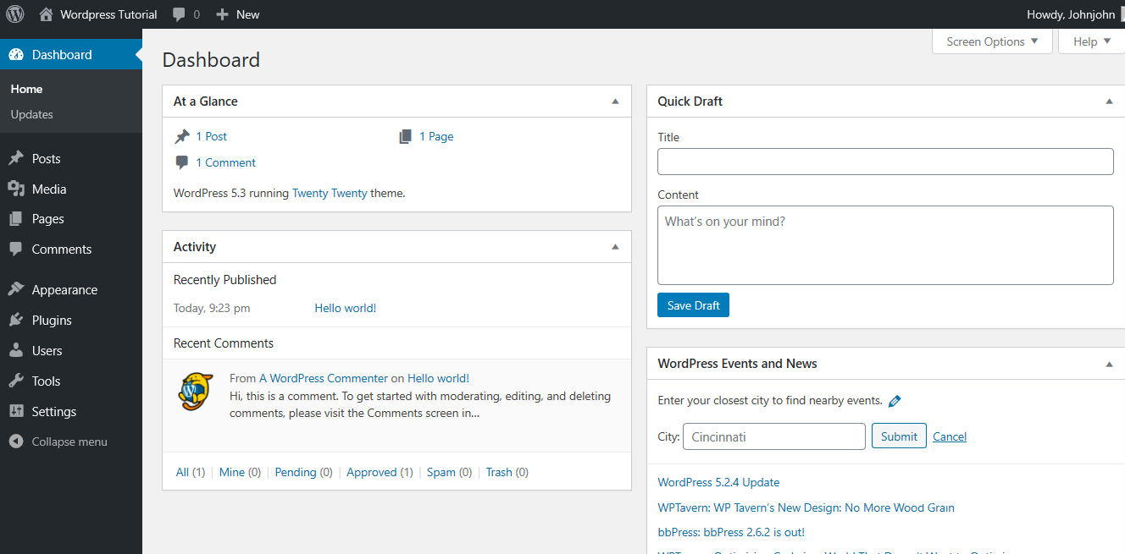

Slide 6
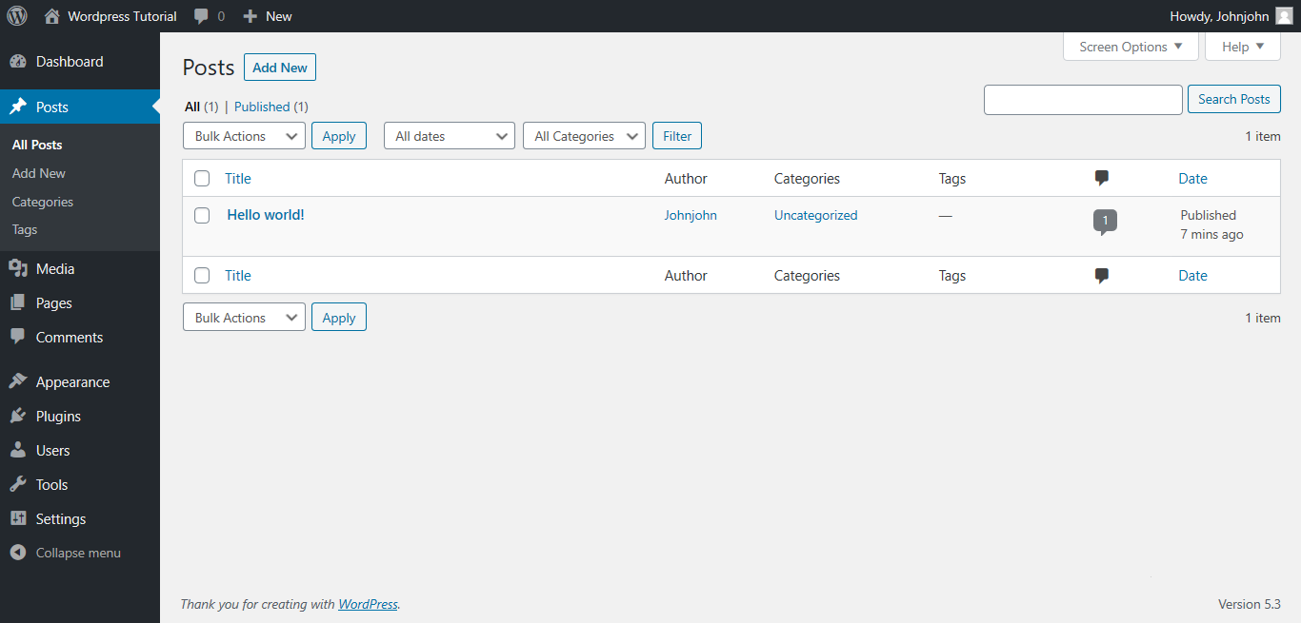

Slide 7
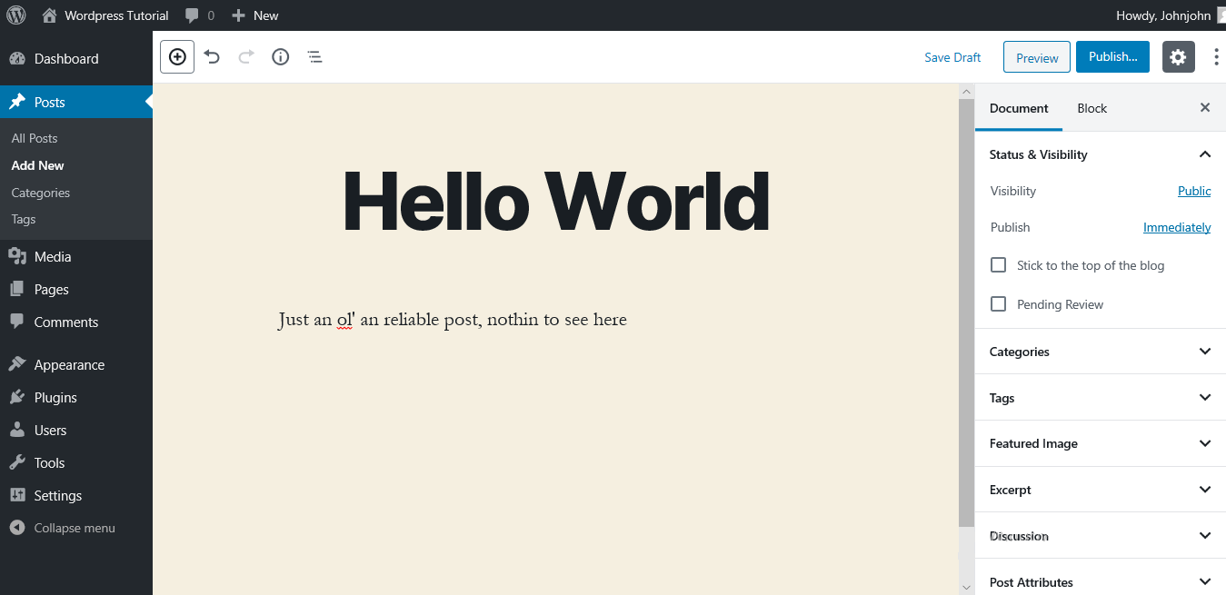

Slide 8
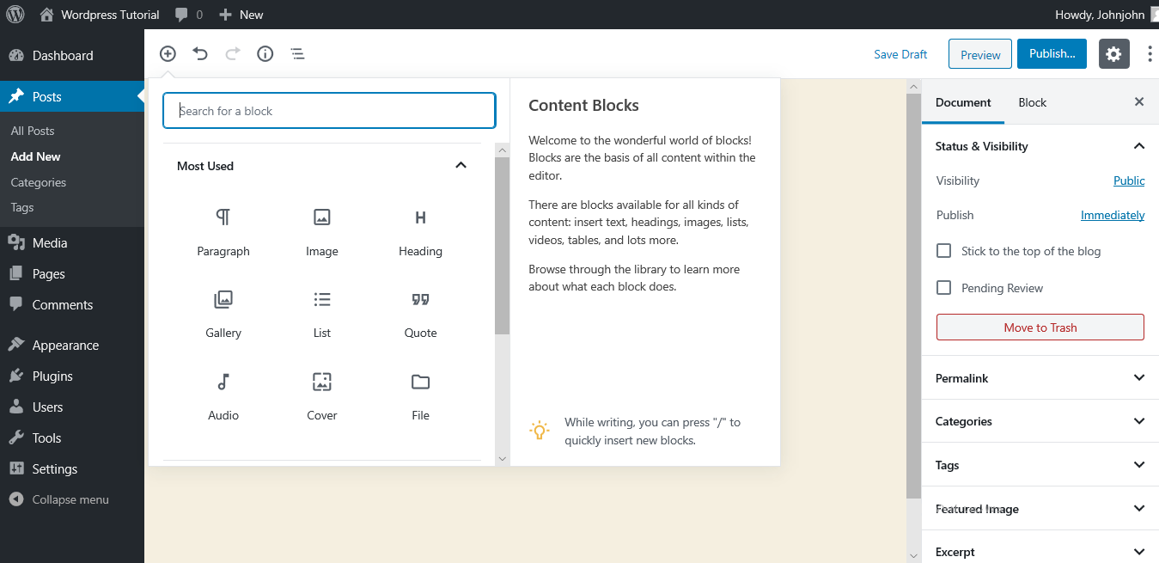

Slide 9
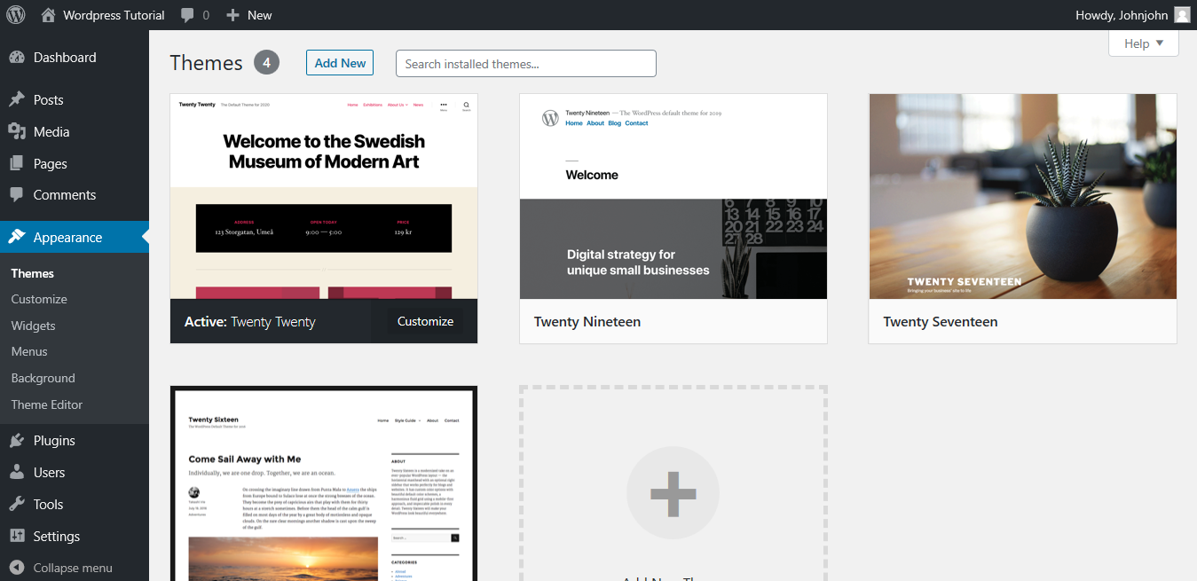

Slide 10
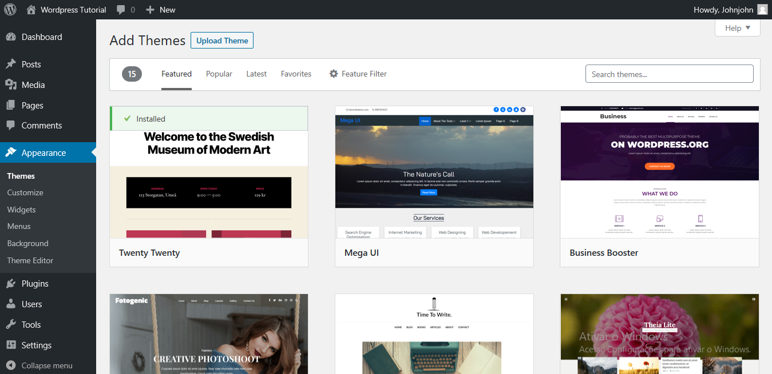

Slide 11
Thank you.

